Slide 1
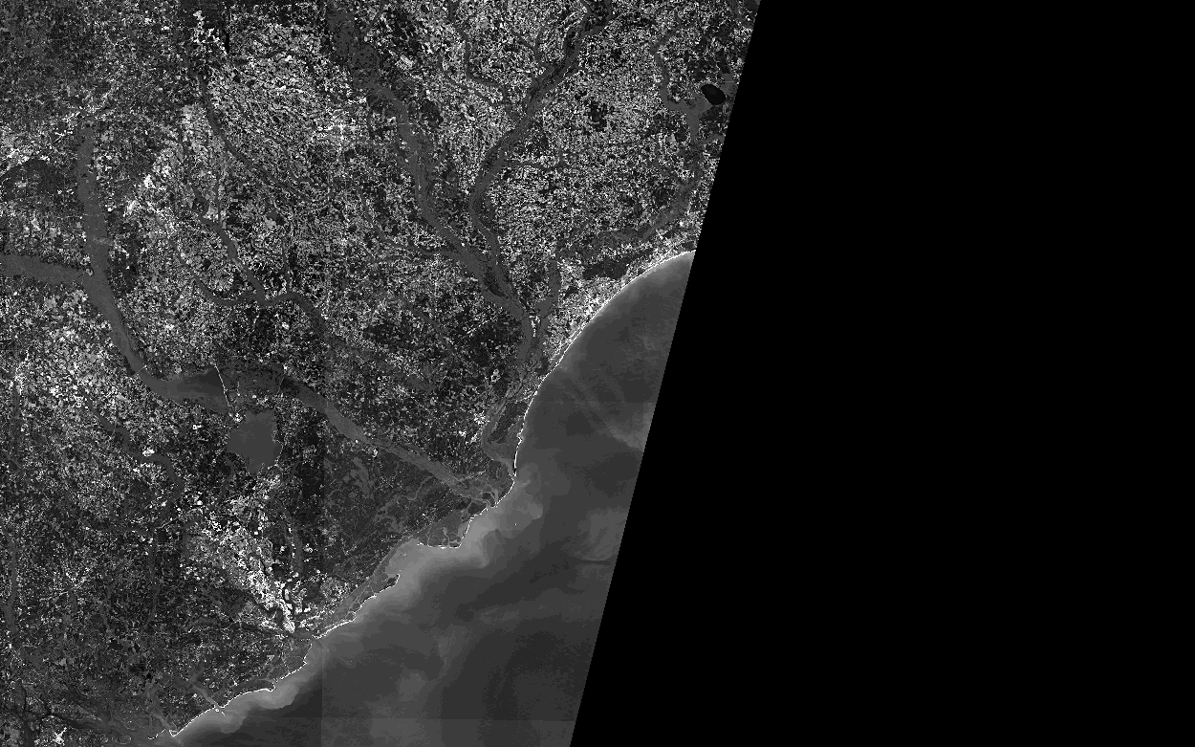
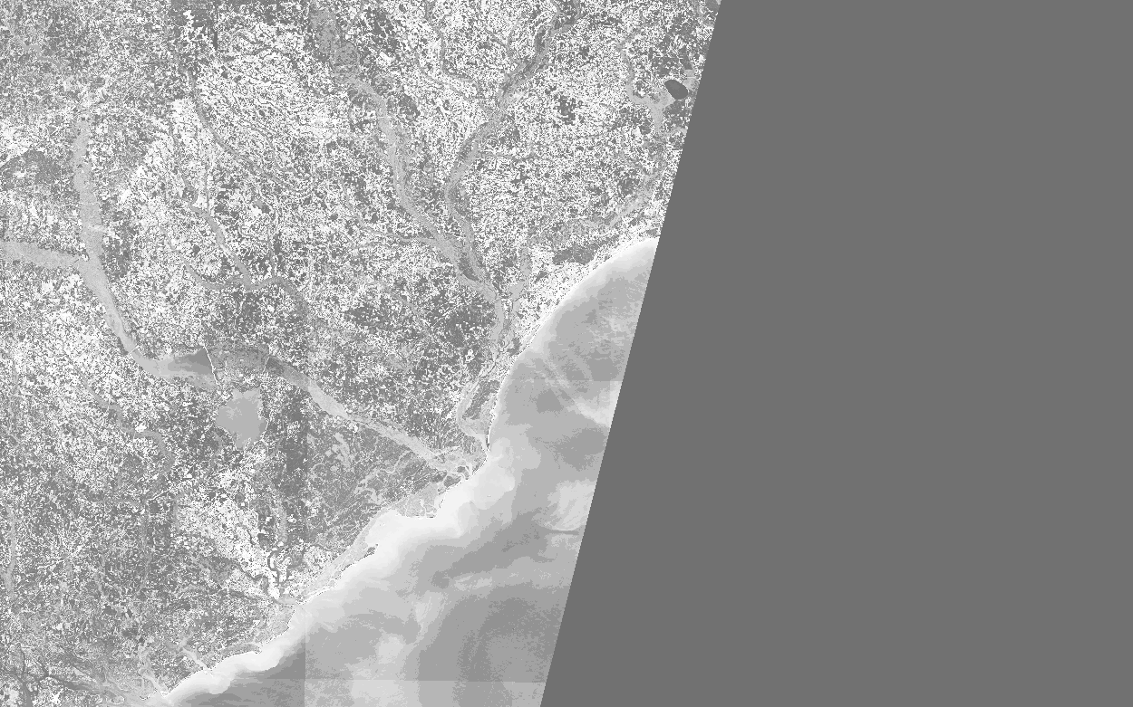
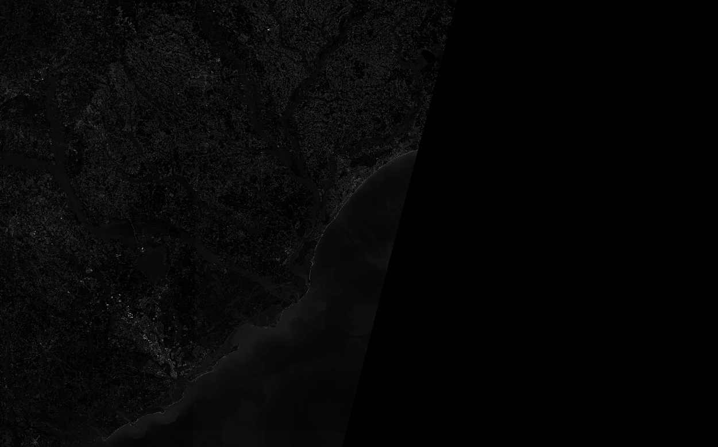
First Steps
My goal was to use a filter after applying some kind of transformation to identify the land vs the water.
First I tried using imadjust() changing variables between 0 and 1 on high lows and gamma to try and change the contrast of the images.
Tried histogram equalization by itself, however there was still too much variability between the images
Image 02 imadjust [0,.1], [0,1], 1
Image 02 Original
Image 12 imadjust [0,.1], [0,1], 1
Image 02 histogram equalization only
Image 02 histogram match only

Slide 2

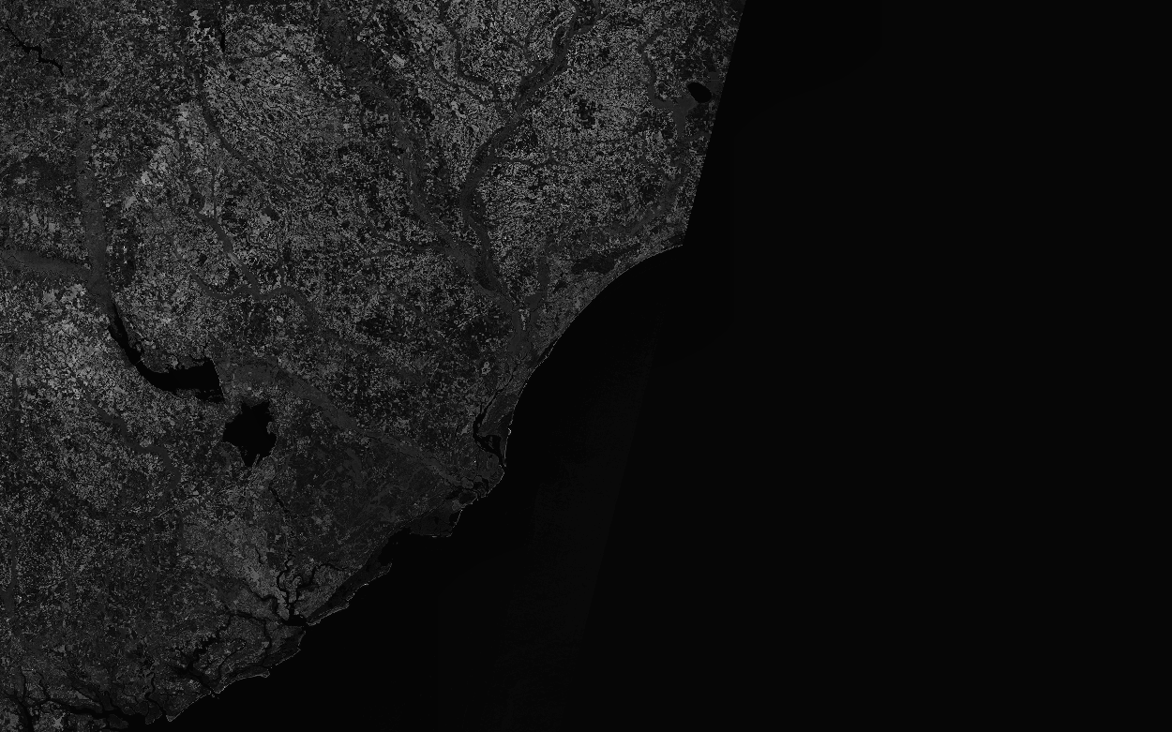
First Steps CONT.
Conclusion: I needed to make the images closer together in contrasts and intensities for good results using the filter
I decided to combine using histogram matching and histogram equalization.
Used image04 to bring the images to similar contrasts before applying histogram equalization to each image separately.
Image 02 Original
Image 02 transformed
Image 12 Original
Image 12 transformed

Slide 3
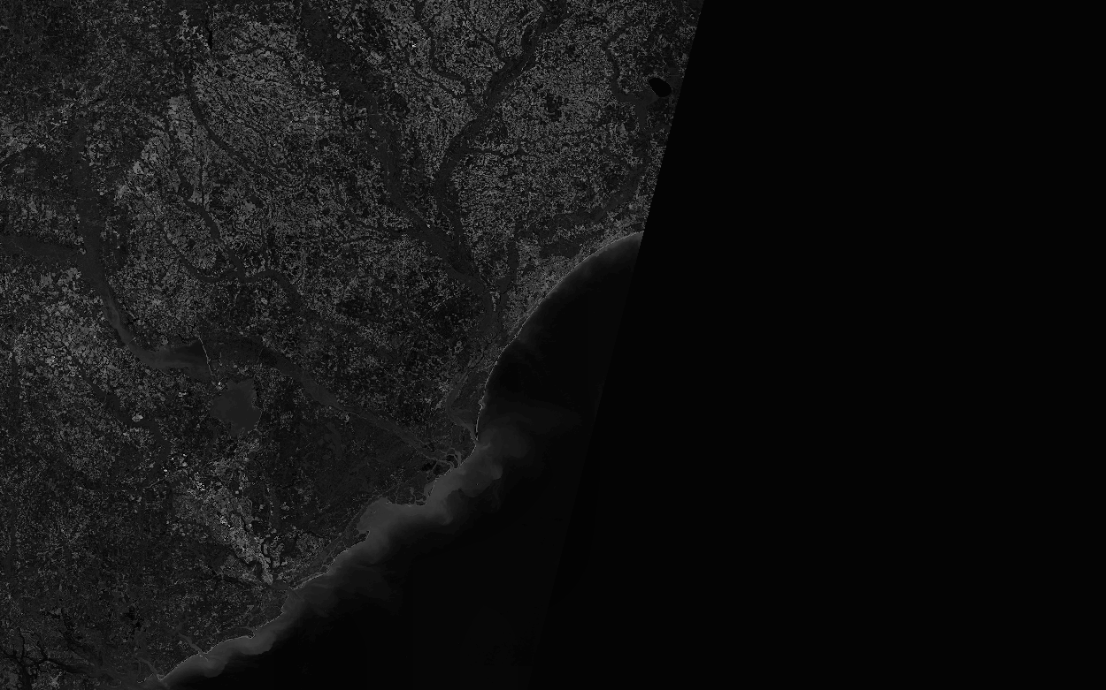
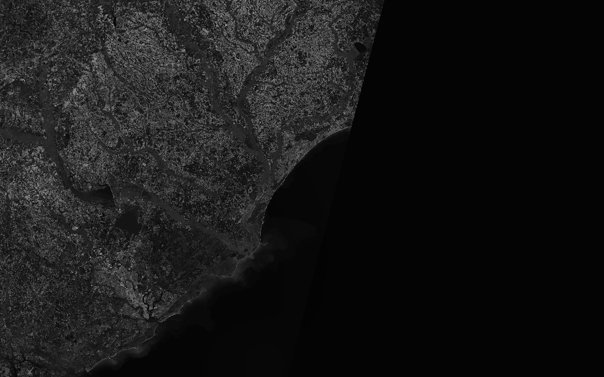
Next
I used imtool to look at each image and compare the intensities of the shallow water vs land intensities.
As you can see the gradual decrease of intensity in the ocean the easiest
Then I applied the mask by using matrix column-wise multiplication. This changed the values in the invalid areas to 0.

Slide 4
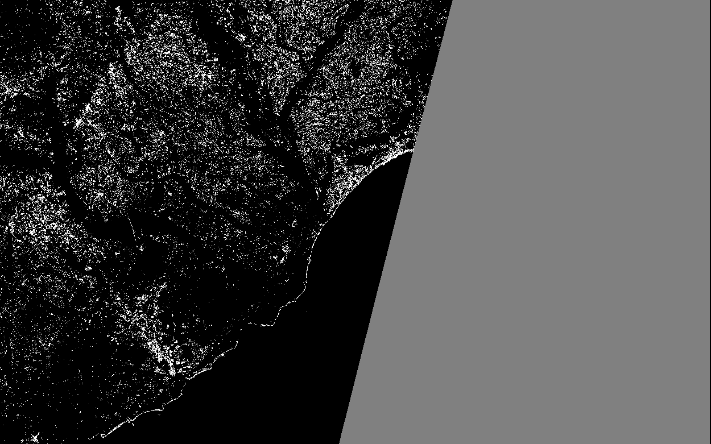
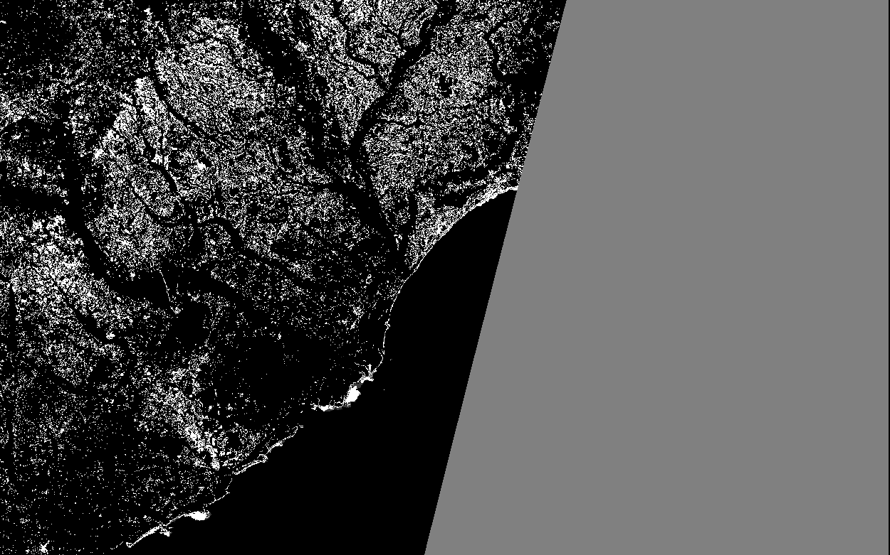
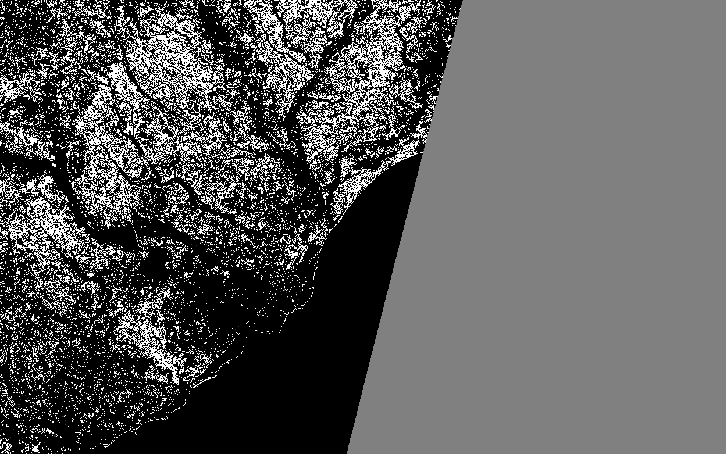
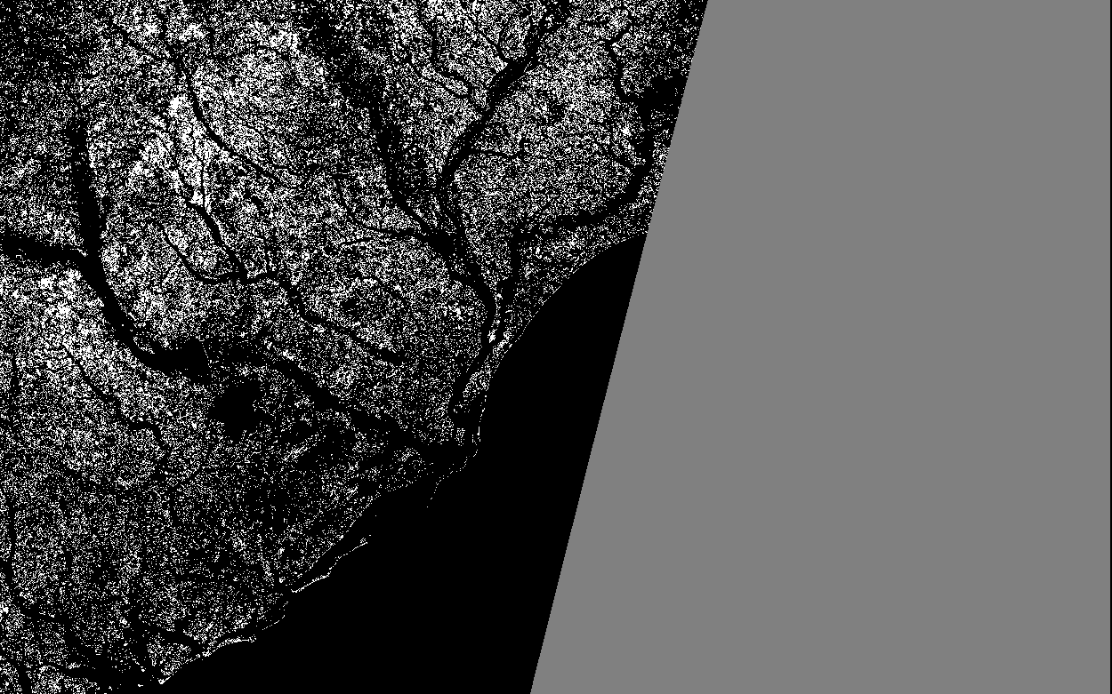
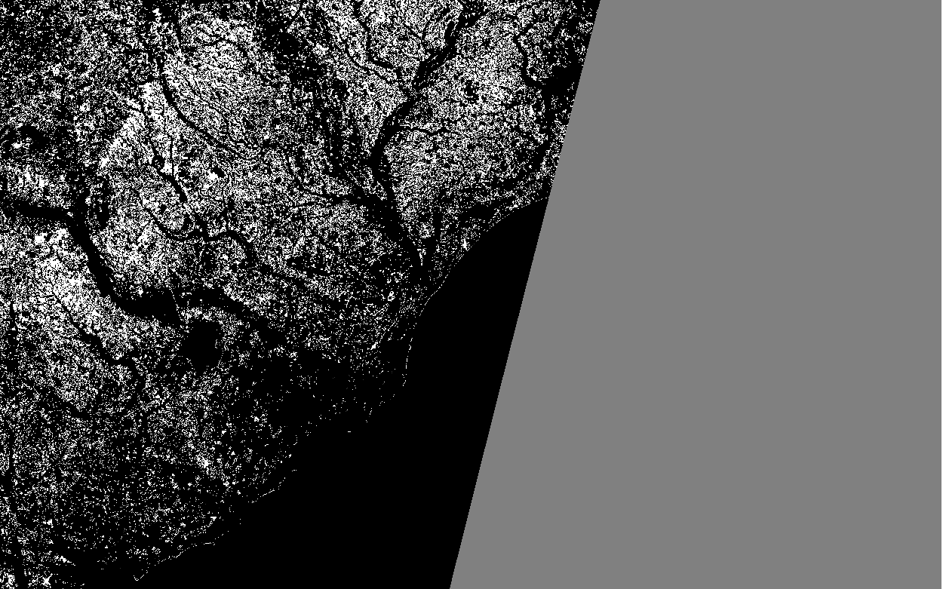
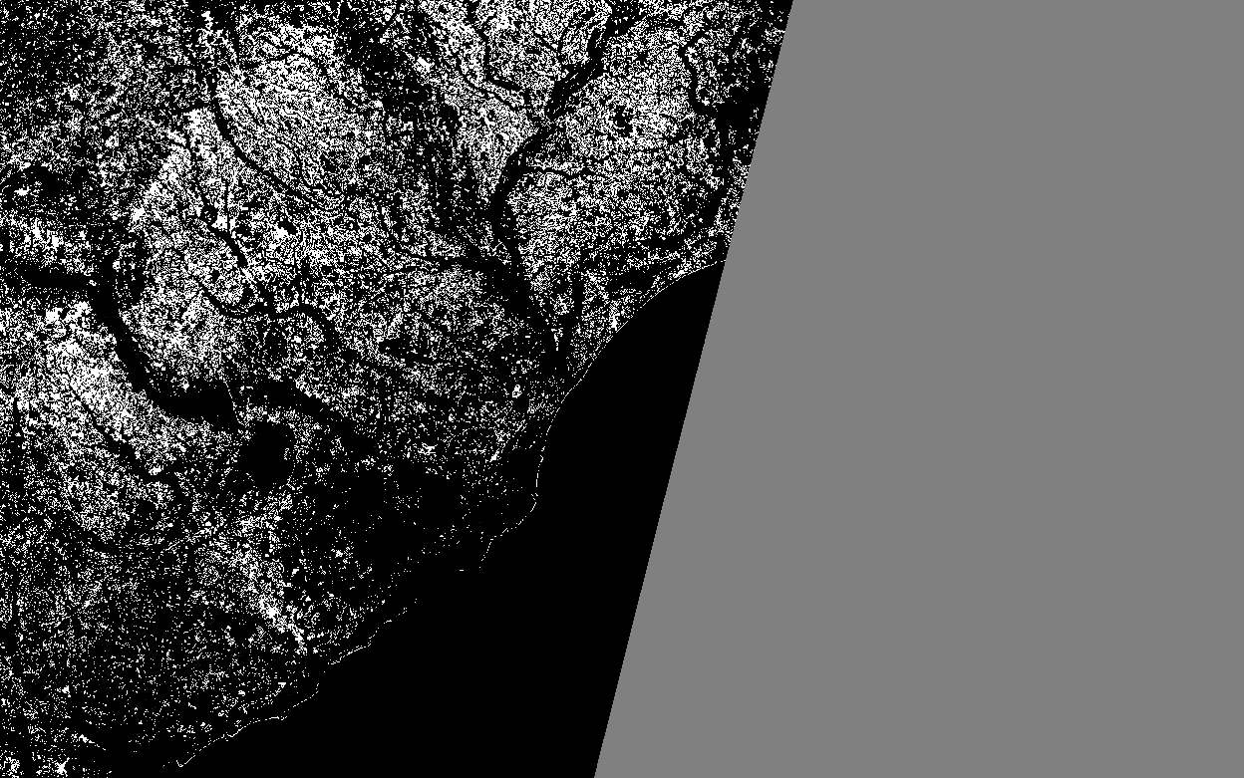
Finally
Used nested for loop to look through intensity at each pixel for each of the 6 images.
If less than an intensity level of 59, I changed to the intensity to 1, did not change previously found land areas.
If it was over the intensity level it became 255, highlighting the land
If the intensity value was a 0, I made it gray or an intensity level of 128. This didn’t affect the water because anywhere the mask wasn’t applied the pixels had a value greater than 0 after the histogram match and equalization.
Image 02 after filter
Image 03 after filter
Image 08 after filter
Image 04 after filter
Image 11 after filter
Image 12 after filter

Slide 5
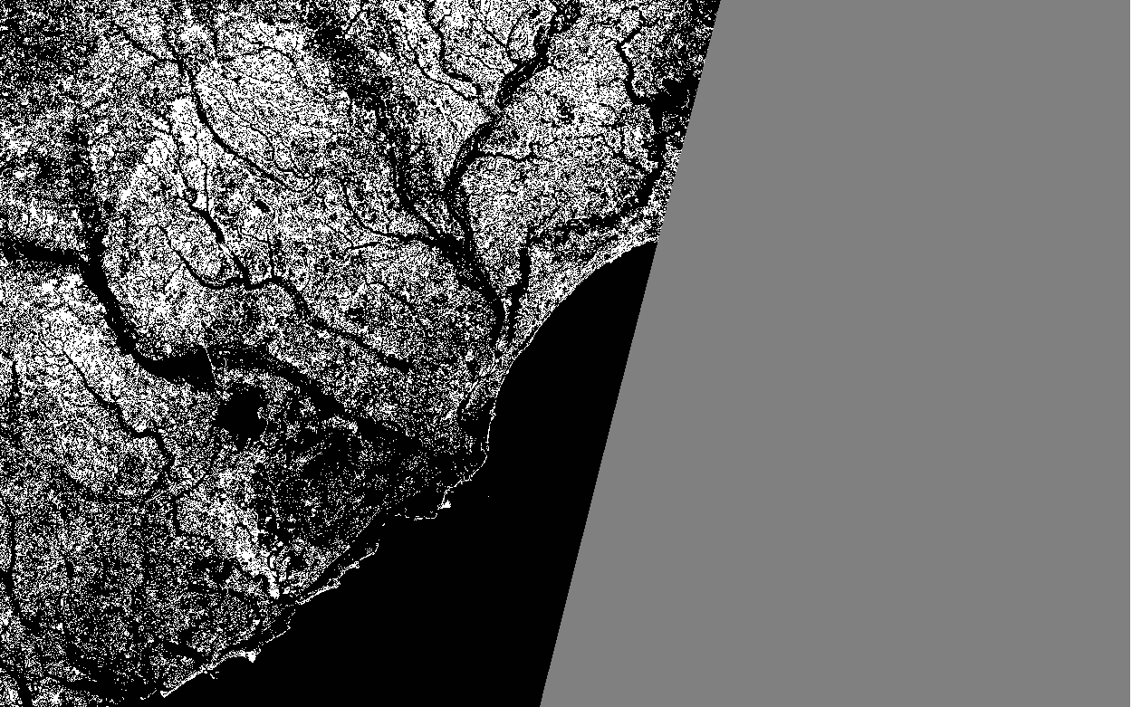
Here is the final result after the transformations were completed and all images were iterated through.
Some of the issues that I ran into was in the heavily vegetated areas of the land, this is why there is still a lot of dark as seen in image02 even after the filter it had a hard time with the marsh and rural areas.
Image 02 after filter

